Slide 1

IPL Visualization Assignment
Rahul Yadav

Slide 2

Match Statistics

Slide 3
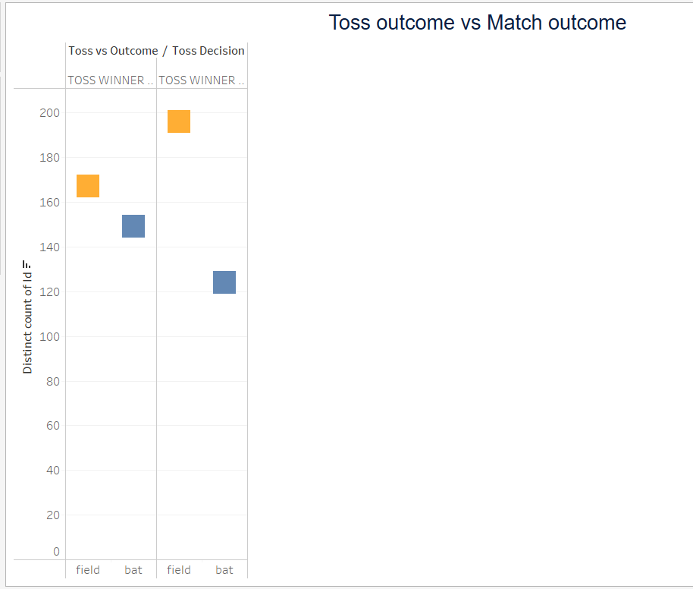
Toss vs Match Outcome

Slide 4
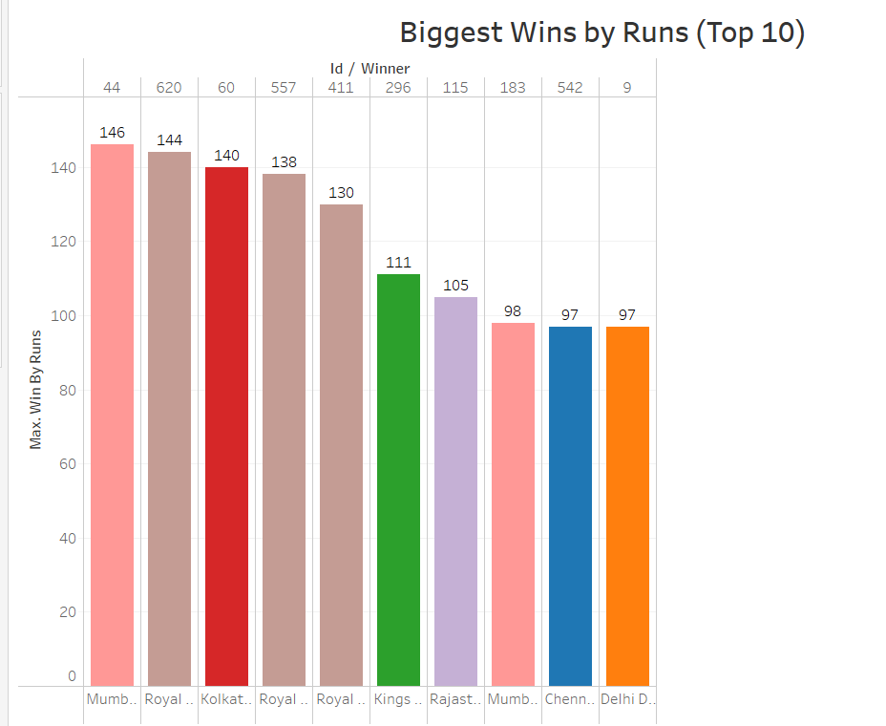
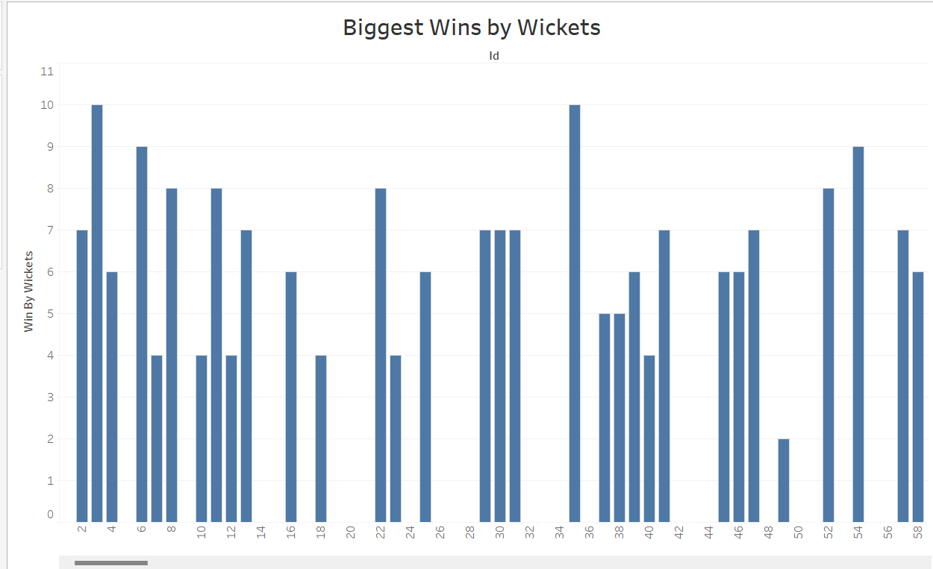
Win By Runs and Wickets

Slide 5
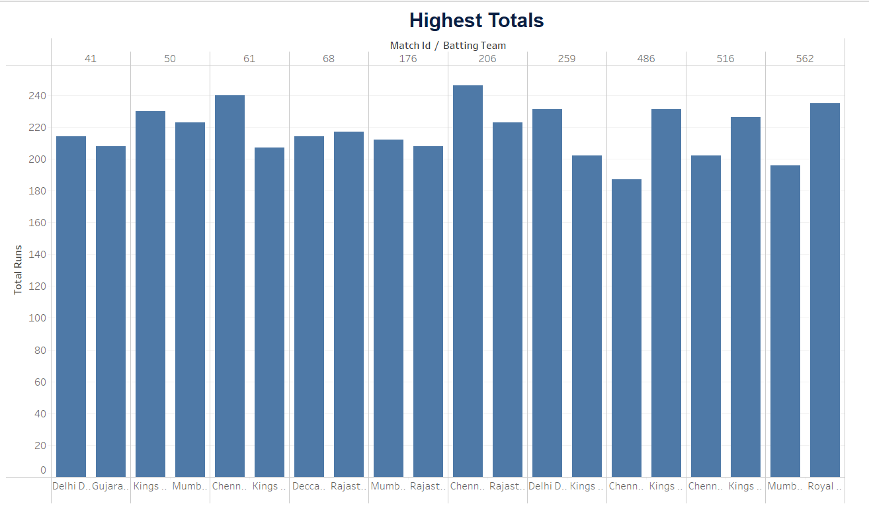
Highest Totals

Slide 6

Player Statistics

Slide 7
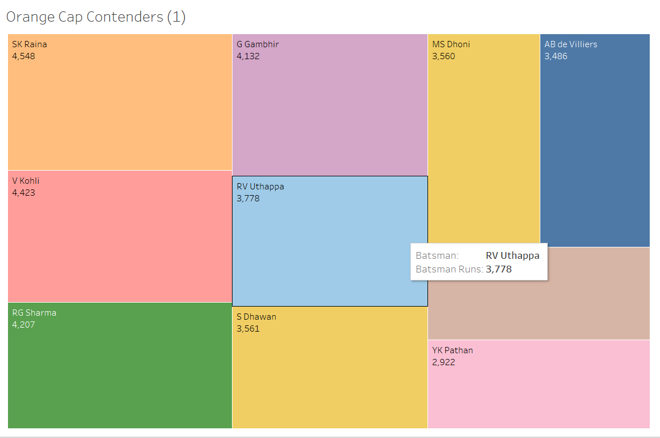
Orange Cap Contenders
The following map has been plotted for finding the top 10 batsmen for all seasons. It can be seen that SK Raina is the top batsmen followed closely by Virat Kohli. The graph can be filtered for every season based on requirement.

Slide 8
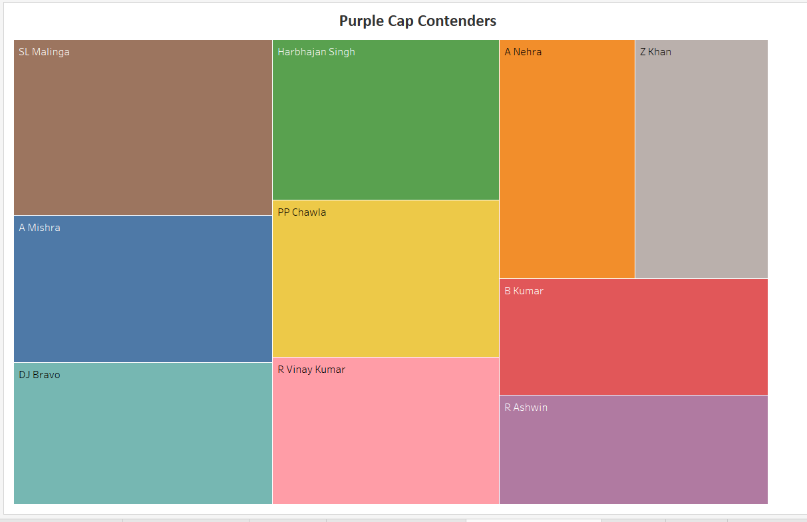
Purple Cap Contenders
The following map has been plotted for finding the top 10 fielders for all seasons. SL Malinga is the top. The graph can be filtered for every season based on requirement.

Slide 9
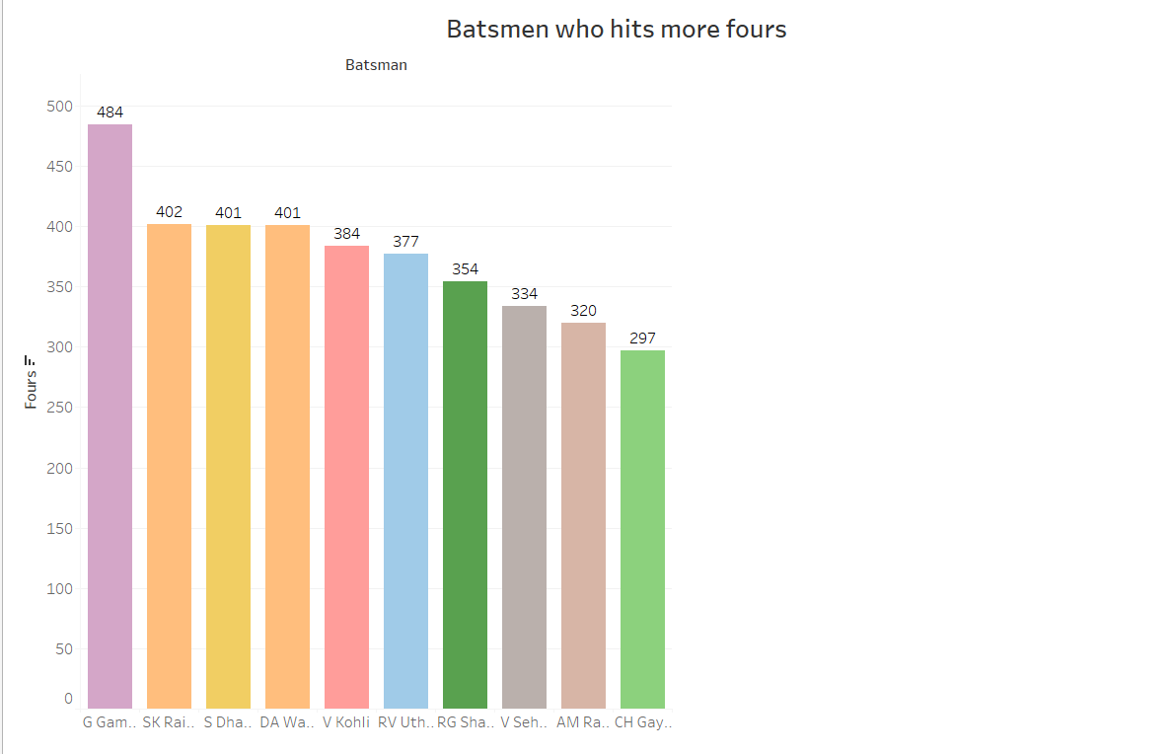
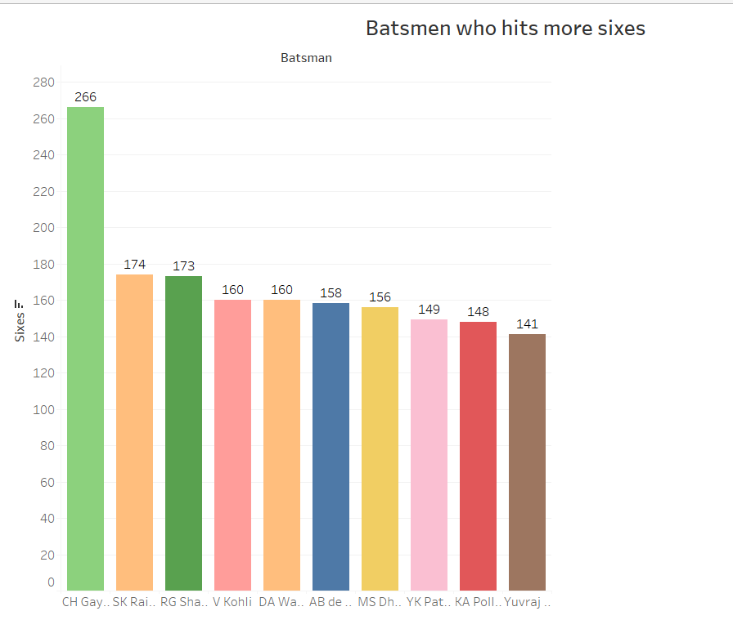
Top Batsmen by Number of 4's and 6's
The following graph portrays the top 10 batsmen over all seasons based on their number of 4’s and 6’s. It can also be filtered for different seasons.

Slide 10

Team Statistics

Slide 11
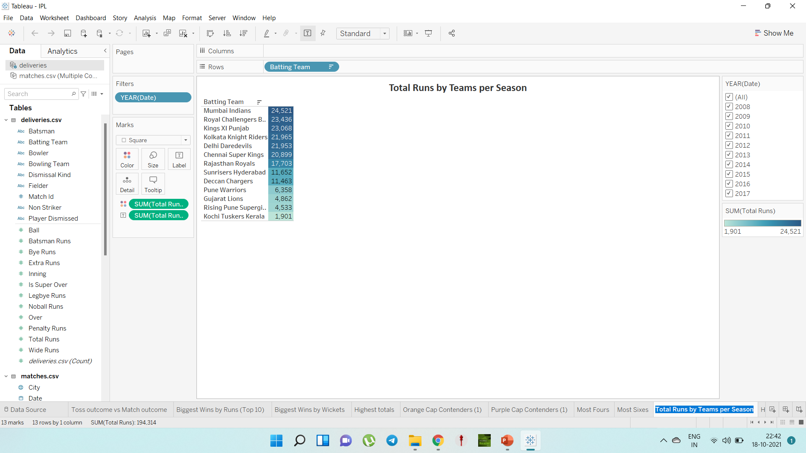
Total Runs by Teams per Season
This bubble chart has been plotted to check the total number of runs made by the teams for all seasons. It can be filtered season wise.

Slide 12
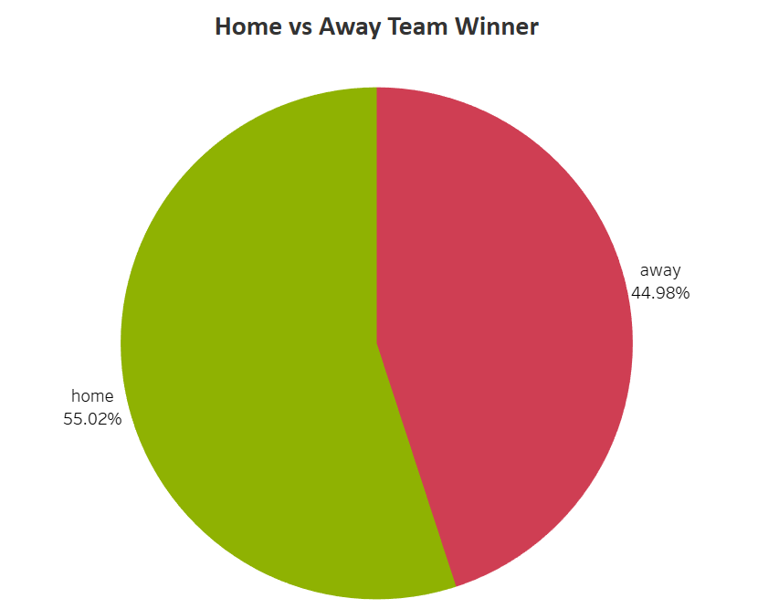
Home vs Away Team Winner
It can be clearly seen that home teams are the usual winners as compared to away teams, though it is by a very small amount of 5%.

Slide 13
Thank you

